Slide 1
Strategic Instruction
Bulldog Focus Groups
2018-2019

Slide 2
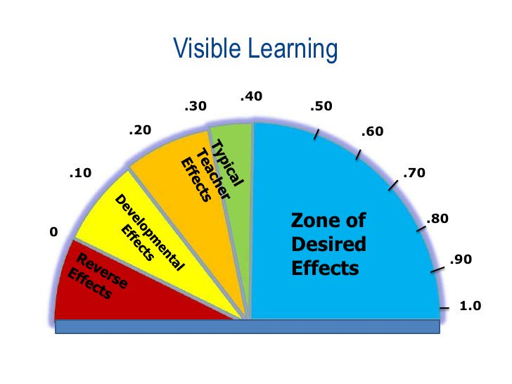
John Hattie’s Effect Sizes

Slide 3
What is this based on?
Research began with Hattie’s metacognitive analysis of 96 studies including 550,339 students.
Hattie created “The Barometer for the Influence” which determines the effectiveness of different strategies and policies on student achievement and improvement.
For example, even though smaller class sizes are desirable, they only rate 0.21 on the barometer. However, high quality student discourse is rated at 0.82 on the barometer of influence. This equals about 2 years of learning growth.

Slide 4
Questioning Strategies
.48 Effect Size

Slide 5
Questioning
Questioning opens up possibilities of meaning.
Questioning is a powerful strategy for building comprehension.
Good questions lead to improved comprehension, learning, and memory of the materials among students.
Notes:
What does questioning look like in your classroom/content area?

Slide 6
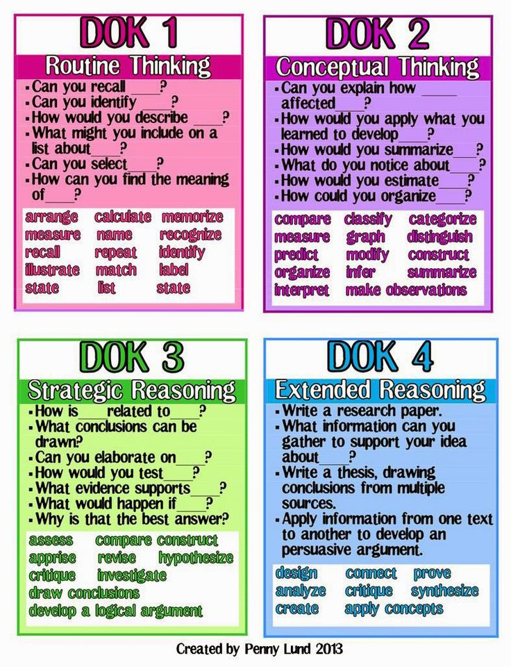
Questioning in the Classroom
Examine the DOK chart.
Reflect on the questions you ask in your classroom.
Where do a majority of your questions fall?
How can you move your questions to higher levels of learning?

Slide 7
Tips for Teacher Questioning
Fail to plan, plan to fail!
Wait time is key!
Don’t rely on the 5 Ws!
There is a time and a place for leading question…
Plan three or more questions to include in your upcoming lessons!

Slide 8
Self-Verbalization and Self-Questioning
Effect Size = .55

Slide 9
Reflecting on the Lesson…
What did I learn today?
Why did I learn this?
How do I know that I learned it?
Did I meet the learning target / standard?

Slide 10
Goals for next time…
Increase the level of questioning in daily lessons.
Include time for strategic student reflection after lessons.

